Slide 1



RECIPE SITE
TRAFFIC
BY OTAMIRI HUMBLE

Slide 2




PROJECT OVERVIEW
Tasty Bytes was founded in 2020 in the midst of the Covid Pandemic. The world wanted
inspiration so we decided to provide it.
Our focus has been on selling products to enable our customers to be more creative, focusedon tools for brainstorming.
We started life as a search engine for recipes, helping
people to find ways to use up the limited supplies they had at home.
Now, over two years on, we are a fully fledged business. For a monthly subscription we will put
together a full meal plan to ensure you and your family are getting a healthy, balanced diet
whatever your budget.
Our focus has been on selling products to enable our customers to be more creative, focusedon tools for brainstorming.

Slide 3





PROJECT OBJECTIVES
Objective n° 1
Objective n° 2
Objective n° 3
Predict which recipes will lead to high traffic
Predict high traffic recipes 80% of the time
Recommend best model to deploy

Slide 4

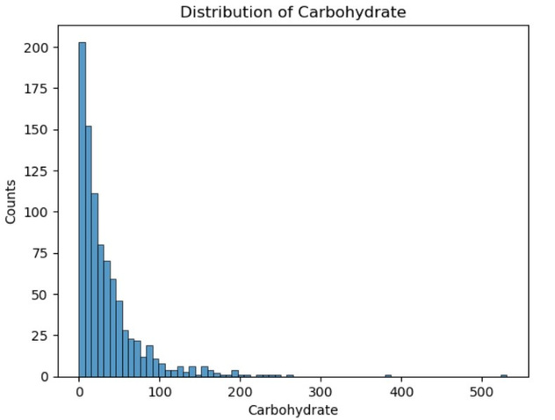
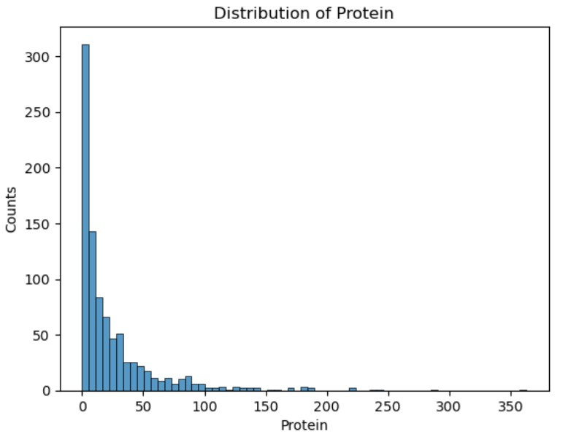
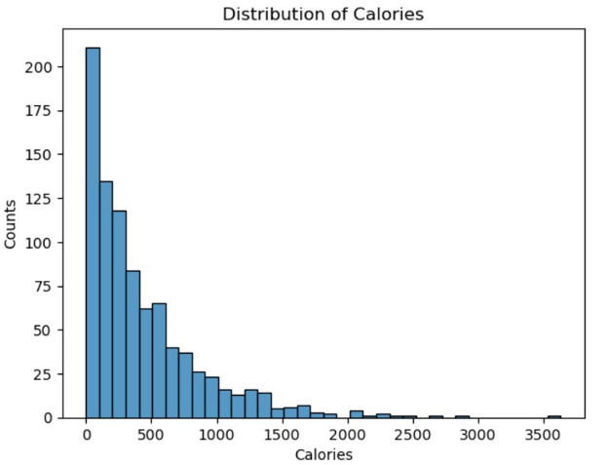
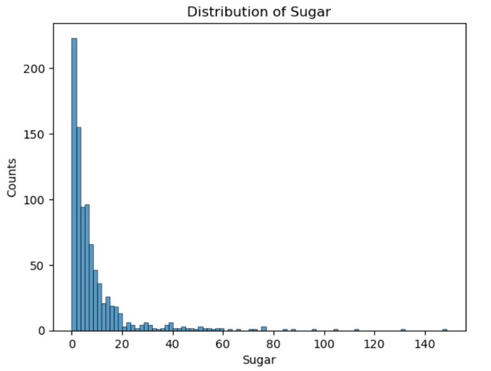
Nutritional Information
The histograms show that all nutritional information columns are left skewed indicating that majority of their values are in the lowest limit

Slide 5
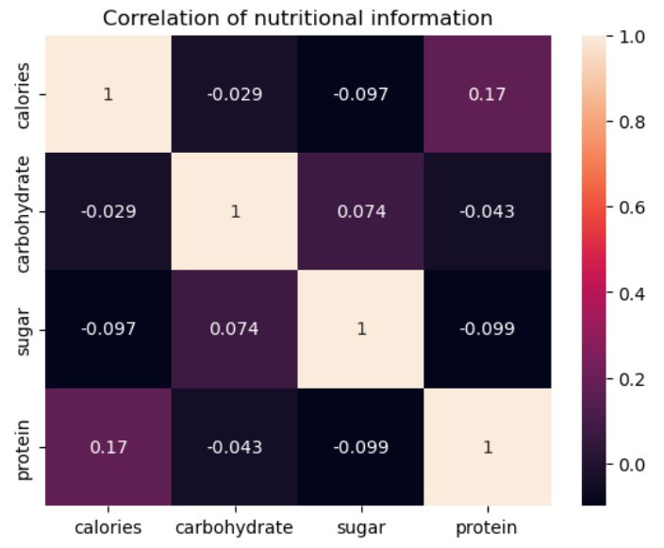
Nutritional Information
There is generally a weak correlation between all nutritional information columns

Slide 6
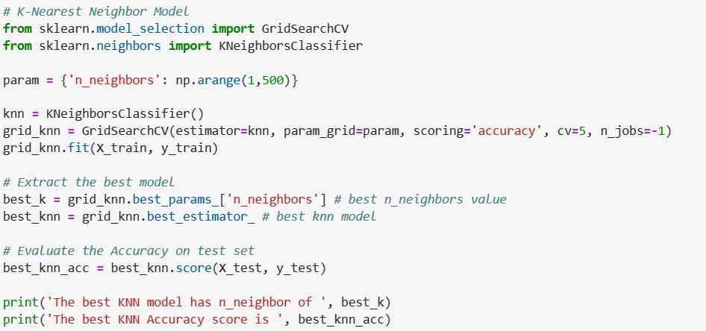

K-Nearest Neighbor Model
The base model, which utilizes KNN, achieved an accuracy of approximately 77.1%. KNN is known for its simplicity and intuitive approach, making it a valuable choice for certain datasets and scenarios. However, it may not perform optimally when dealing with high-dimensional or noisy data, as it relies on proximity to neighbors.

Slide 7
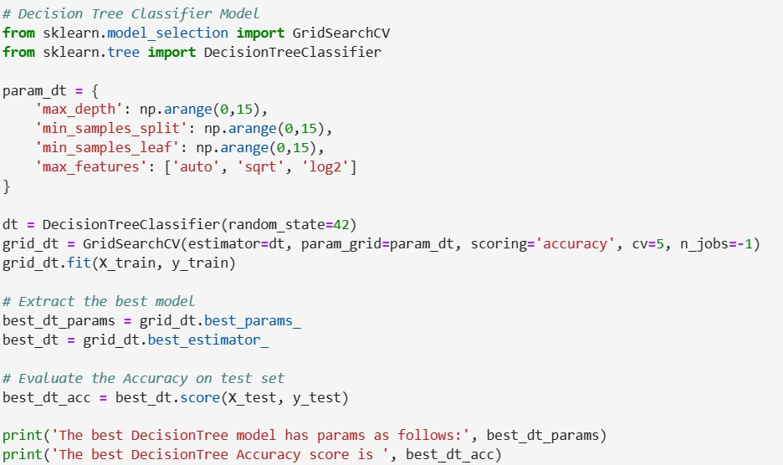
Decision Tree Classifier Model
The comparison model, employing the Decision Tree Classifier, achieved a slightly higher accuracy of around 77.7%. Decision trees are interpretable and can capture complex relationships within the data. They are versatile and perform well on various types of datasets.

Slide 8
Business Metrics
Accuracy: Percentage of Predictions of Recipe with High Traffic
This metric evaluates the performance of two predictive models (Decision Tree Classifier and K-Nearest Neighbors - KNN) by measuring the percentage of predictions of recipe with potential high traffic.
The results indicate that the Decision Tree Classifier achieved an accuracy of 77.65%, while the KNN model achieved an accuracy of 77.09% in predicting the recipe with potential high traffic. These percentages reflect the models' ability to provide predictions, which can be a valuable metric for assessing their performance in real-world applications.
It is important to note that both models didn't achieve 80% prediction but implementing the recommendations might result to an improvement towards achieving that target.

Slide 9
Recommendations
Continue to monitor and evaluate the performance of both models over time. Accuracy is an essential metric, but consider other relevant metrics such as precision, recall, and F1-score
Explore ensemble methods, such as model stacking or voting, that combine the predictions of both models.
Fine-tune the hyper-parameters of both models further to see if performance can be improved using other fine-tuning techniques
Assess the importance of features used in the models and consider feature engineering techniques to create new relevant features.
Ensure data quality and consistency in the dataset.

Slide 10

THANK'S FOR WATCHING

